Slide 1

From 10 Terabytes to Zero Parameter: The LLM 2.0 Revolution Vincent Granville, PhD Chief AI Architect BondingAI.io vincent@BondingAI.io May 15, 2025, 2024
No-GPU Full Context Secure Multi-LLM
with Real-Time Fine-Tuning & Explainable AI

Slide 2
No-GPU Full Context Secure Multi-LLM with Real-Time Finetuning & Explainable AI Vincent Granville, PhD, Co-Founder, Bonding AI & GenAItechlab.com vincentg@mltechniques.com October 27, 2024

Slide 3
Agenda
Why xLLM? What is it?
xLLM Innovative Features
xLLM Architecture and Evaluation
xLLM for Clustering, Data Synthetization, Predictive Analytics
What is coming UP next?
References

Slide 4
Part 1 Why xLLM? What is it?

Slide 5
Extreme LLM (xLLM) in a Nutshell
Mixture of experts
Specialized sub-LLM and/or sub-LLMs for authorized users
LLM router to manage the sub-LLMs
User selects sun-LLM, agent, and hyperparameters
Each sub-LLM built with its own taxonomy and knowledge graph
No neural network, no training
Thus, low cost, easy to fine-tune in real-time
Self-tuned based on favorite hyperparameters, and customizable
No GPU, no latency, exhaustive concise results, local implementation
Concise results
Multiple sections displayed to user: links, related content, x-embeddings
Output with relevancy score attached to each item in each section; User offered choices for deeper or alternate queries
Great for search, for professional users and experts. Not just a “prompt box”; many options in the UI, like a mini browser
Case studies
Corporate corpus with augmented sources (content + taxonomies)
Wolfram corpus: 15 sub-LLMs, 500 sub-categories per sub-LLM
Publisher, 4000 titles: clustering, predicting article performance

Slide 6
Extreme LLM (xLLM) in a Nutshell
Mixture of experts
Specialized sub-LLM and/or sub-LLMs for authorized users
LLM router to manage the sub-LLMs
User selects sun-LLM, agent, and hyperparameters
Each sub-LLM built with its own taxonomy and knowledge graph
No neural network, no training
Thus, low cost, easy to fine-tune in real-time
Self-tuned based on favorite hyperparameters, and customizable
No GPU, no latency, exhaustive concise results, local implementation

Slide 7
Extreme LLM (xLLM) in a Nutshell
Concise results
Multiple sections displayed to user: links, related content, x-embeddings
Output with relevancy score attached to each item in each section
User offered choices for deeper or alternate queries
Great for search, targeted to busy professional users and experts
Not just a “prompt box”; many options in the UI, like a mini browser
Case studies
Corporate corpus with augmented sources (content + taxonomies)
Wolfram corpus: 15 sub-LLMs, 500 sub-categories per sub-LLM
Publisher, 4000 titles: clustering, predicting article performance

Slide 8
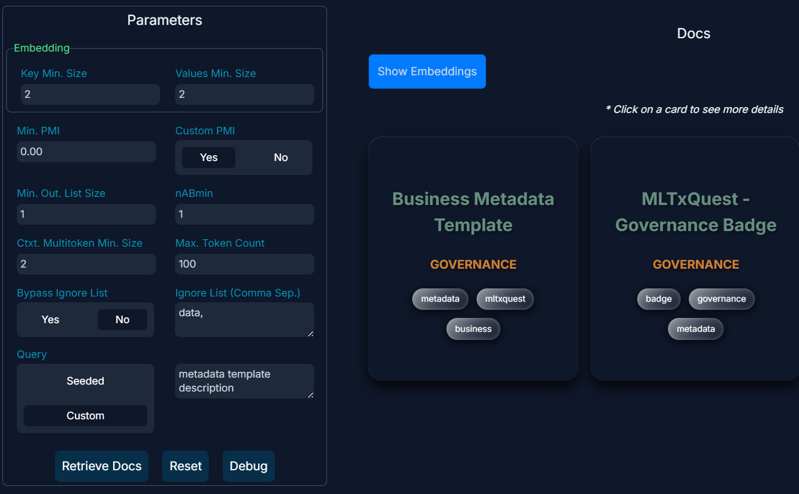
Prompt Results – Card Format (web API)

Slide 9
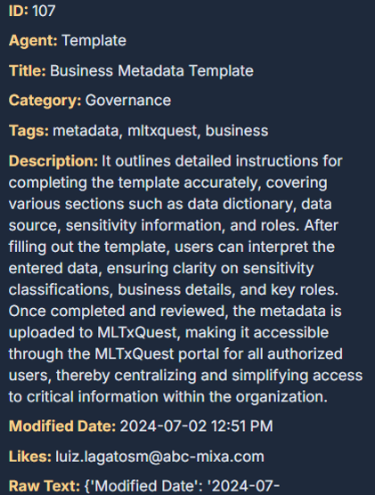
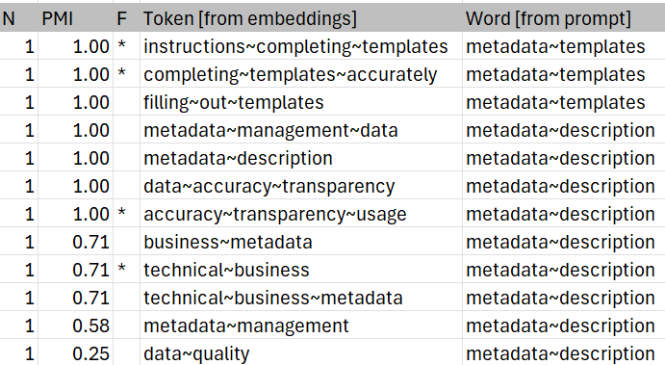
Prompt Results – Card Format (web API)

Slide 10
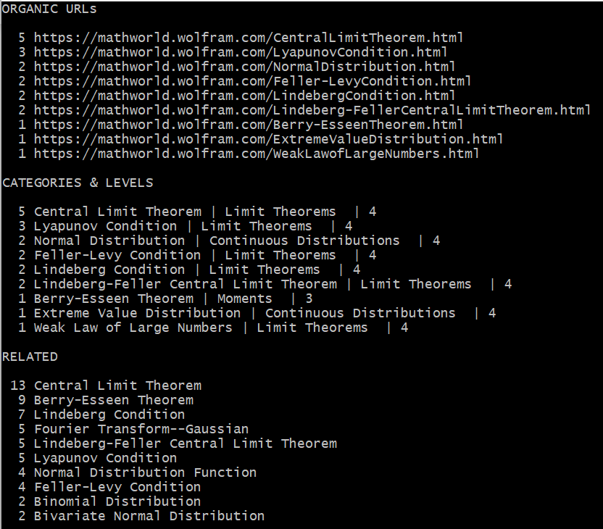
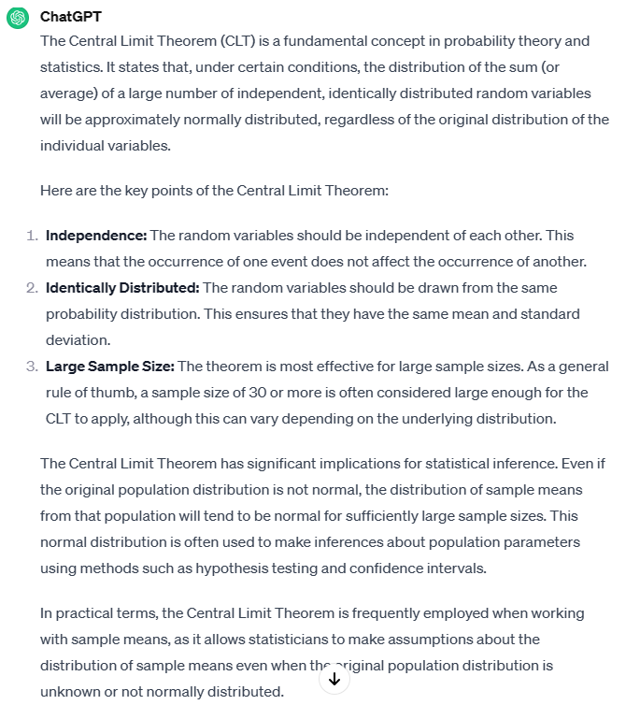
Prompt Results – Listing Format (1)

Slide 11
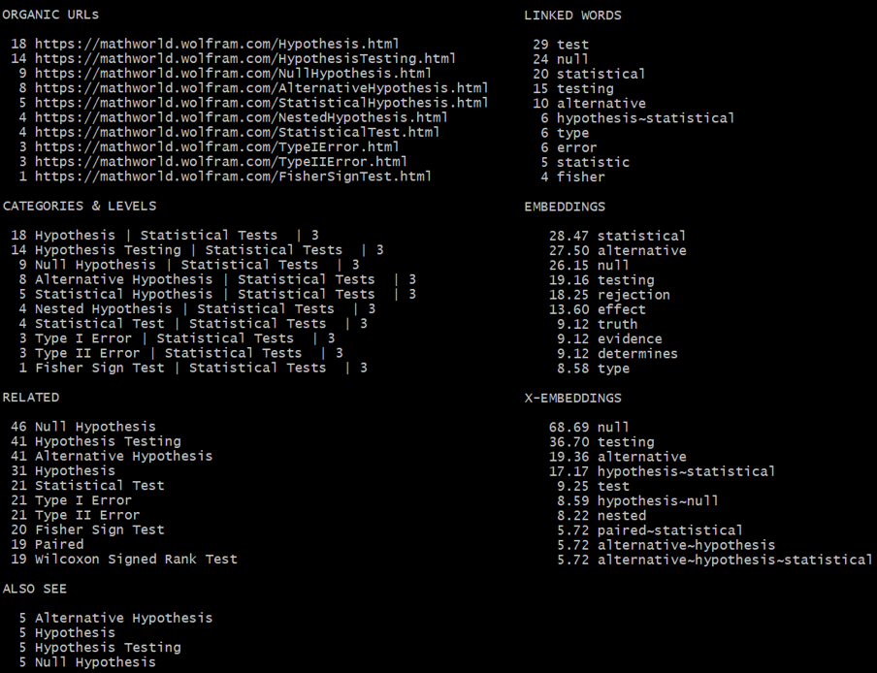
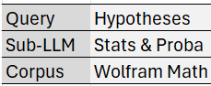
Prompt Results – Listing Format (2)

Slide 12
Prompt Results – Text Format
Text entities retrieved from corpus via context chunking / indexation
Blended with images, datasets, URLs and so on (multimodal)
Knowledge graph elements included: categories, tags, related content, agents
Generating English output (prose) with GenAI
Coming soon, different from simple text retrieval
Turn output into English summary
Pre-made customizable synthetic answers (template answers)
Blending AI with classic ML: integrating external tools with large list of pre-made, customizable template sentences to display in prompt results

Slide 13
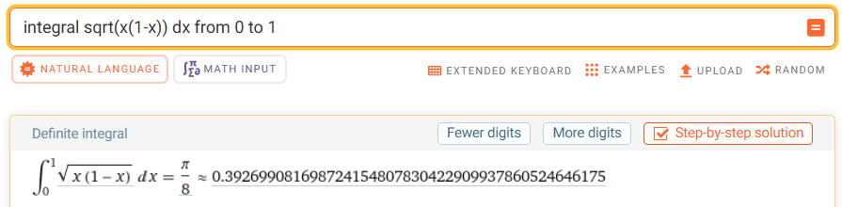
xLLM Integration with other APIs and LLMs
Leverage and blend capabilities of multiple LLMs (GPT, Perplexity, Mistral, etc..)
Use external GenAI tools or libraries to turn output into nice, fluid English text
CodeValet API for code generation
Wolfram/Mathematica API to solve math problems

Slide 14
Part 2 xLLM Innovative Features

Slide 15
Backend Features
Smart crawling to retrieve embedded structure
Breadcrumbs (enterprise corpus), concept associations (related links)
Metadata, tags, taxonomy (category graph)
Augmented with user prompts
Augmented with PDFs (TOC, index, glossaries, synonyms, titles)
X-embeddings
Variable-length embeddings stored as sparse nested hashes
Multi-token: “data~science” on top of single tokens “data” and “science”
Contextual token: “data^science”, both words in same paragraph but not adjacent
PMI (pointwise mutual information) instead of dot product / cosine distance
Parametric weights attached to tokens (no loss function to optimize)

Slide 16
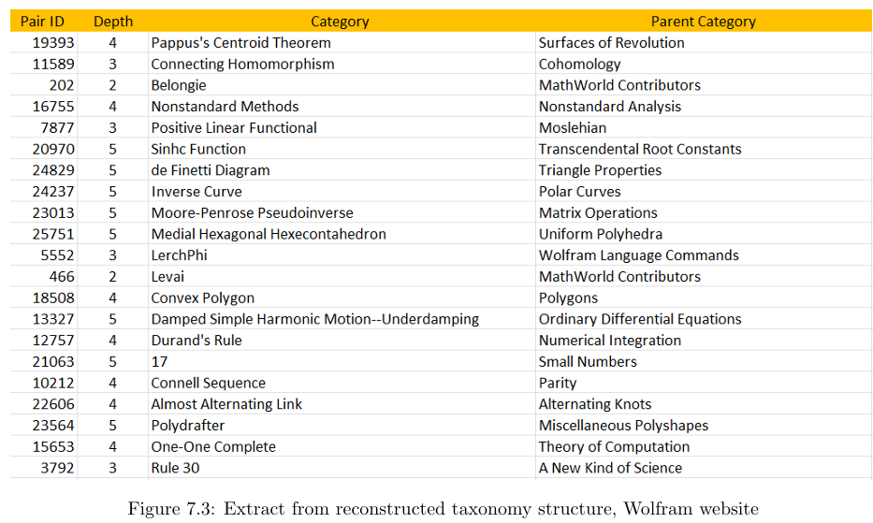
Retrieved Taxonomy: Wolfram Example

Slide 17
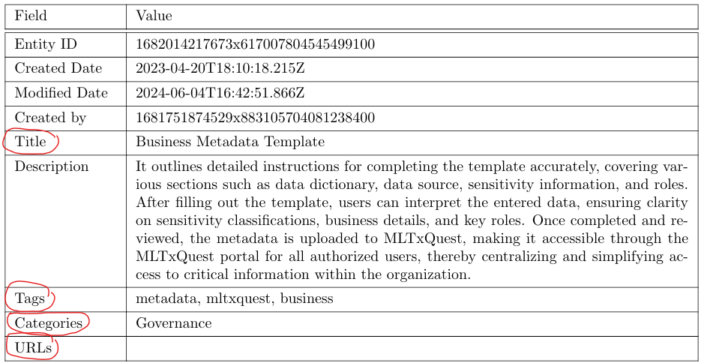
Retrieved Context: Enterprise Example

Slide 18
Backend Features (Cont.)
Home-made libraries
Issues with Python libraries (singularize, autocorrect, “Feller” changed to “seller”)
Minimize stemming and text transforms; keep plural if found in corpus
Important: accented characters, separators (punctuation), capital letters
Ad-hoc lists: home-made stopwords, do-not-singularize, do-not-autocorrect
Backend tables (specific to each sub-LLM)
X-embeddings not the most important table; taxonomy more important
Compression mechanism: sorted n-grams
Backend parameters

Slide 19
Backend Features (Cont.)
Chunking & Indexing
Chunks called text entities: webpage, subsection (PDF), or JSON entity
Indexed for fast retrieval of full content, and for easy content linking
Chunks of variable length
NLP
Python with workarounds + homemade
Weighted graph tokens: multi-tokens found in the context/taxonomy elements
Customized pointwise mutual information (PMI), instead of cosine similarity

Slide 20
Backend Features (Cont.)
Augmentation
Easy integration of external sources, tested on corporate corpus
External content flagged via tags or other context elements
User told if piece of output is internal or external
Taxonomy augmentation
Agents
Assigned post-crawling to text entities via clustering, for easy matching with prompt
Different from standard implementations (bottom up rather than top down)
Content Deduping

Slide 21
Frontend Features
User Interface
Many options, not just a search box (see previous slide)
User can choose agents, sub-LLM, or fine-tuning in real time
End-user debugging with catch-all parameter set
Relevancy scores
Goal: too many results to show to user prompt, which ones to display?
Graph tokens and multi-tokens with 2+ words boost score
Text entity with 2+ multi-token intersection with prompt, get higher score
Rare multi-tokens get extra boost
Longer text entities get extra boost

Slide 22
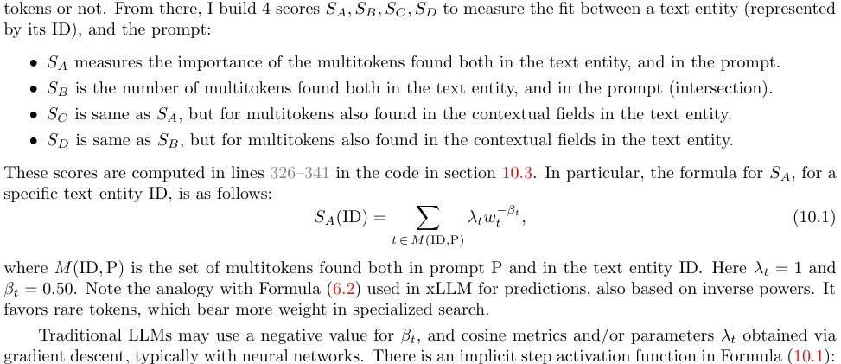
Relevancy scores

Slide 23
Frontend Features (Cont.)
Distillation
If multi-tokens A~B~C and A~B have same count, show results from A~B~C, not A~B
Acronyms and synonyms
If A and B are synonyms, A in prompt but not in corpus, and B in corpus, map A to B in the prompt to retrieve B in the corpus (Goal: trying to be exhaustive)
Self-tuning – Most popular front-end parameters used to build default parameters
Prompt cleanup with stopwords list different from backend list
Disambiguation (coming soon)

Slide 24
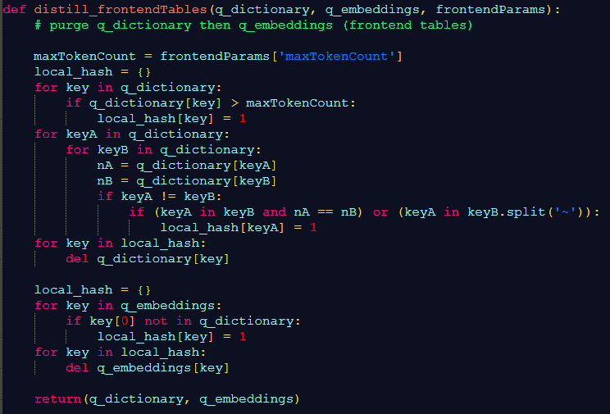
Distillation

Slide 25
Part 3 xLLM Architecture and Evaluation

Slide 26
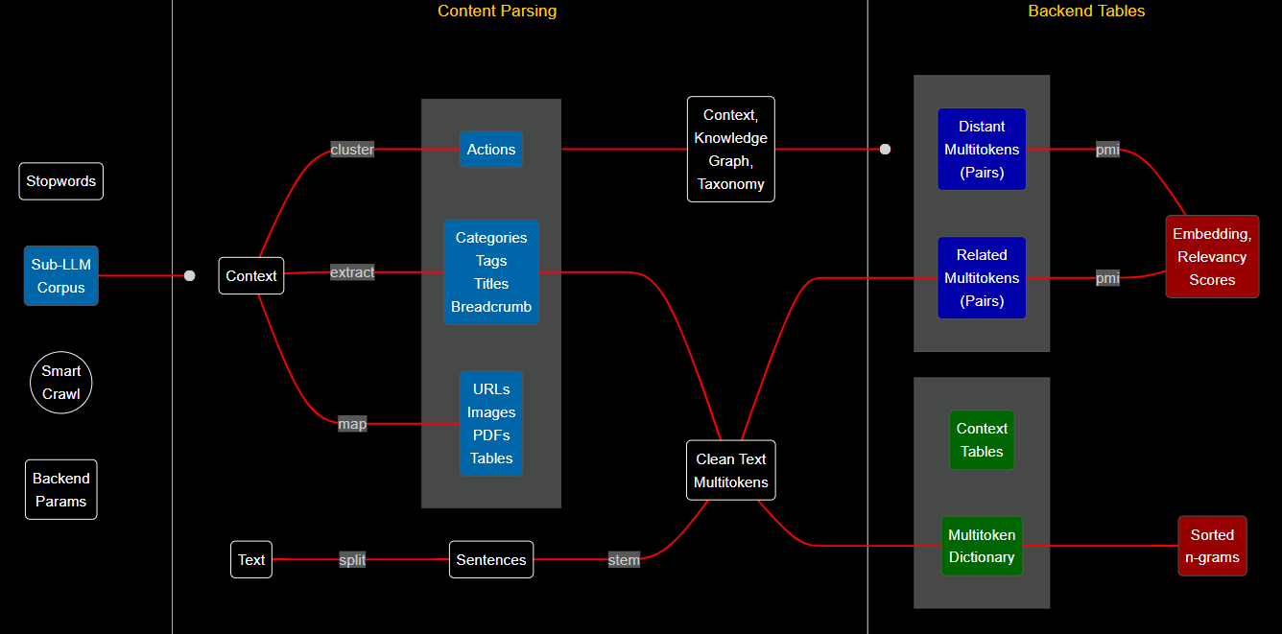
Backend: Overview

Slide 27
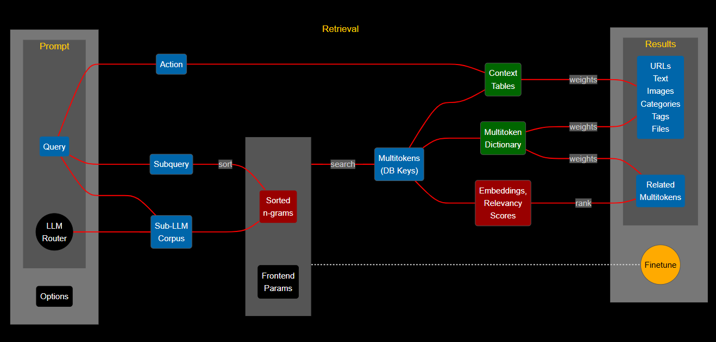
Frontend: Overview

Slide 28
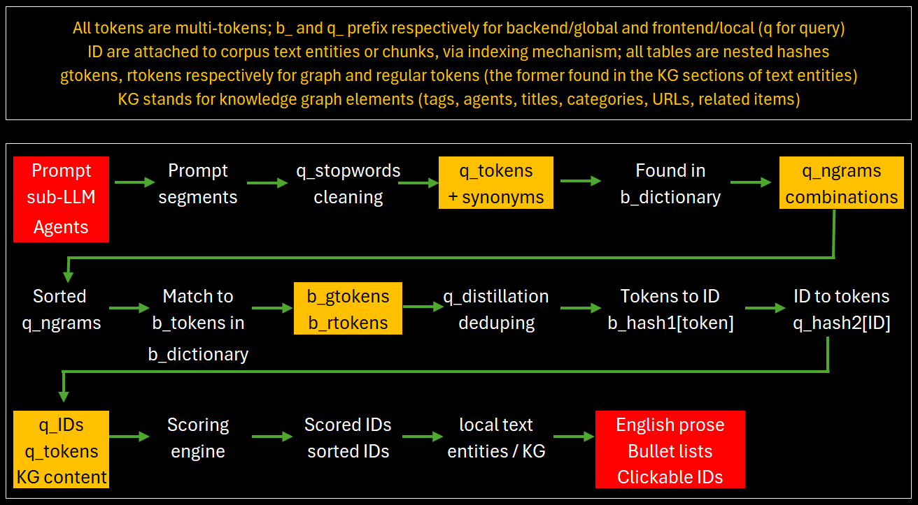
Path from Prompt to Results

Slide 29
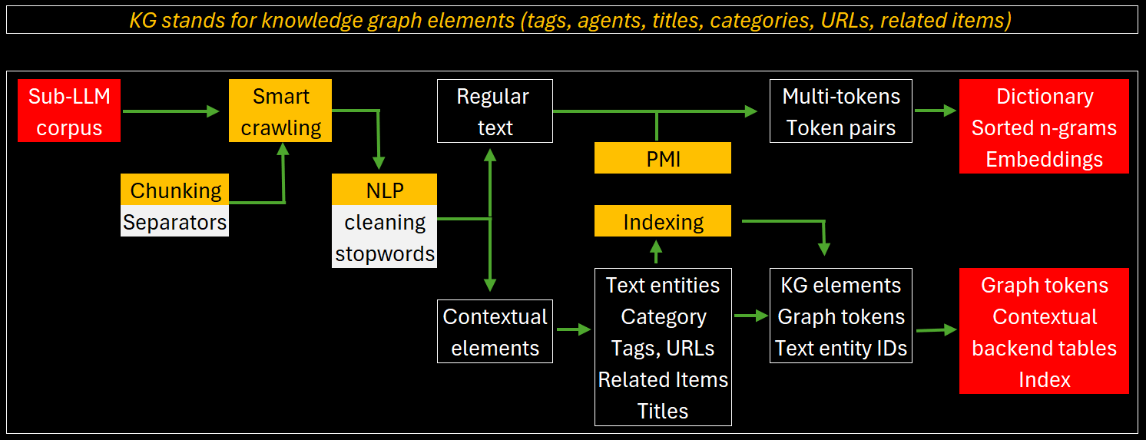
Path from Crawl to Backend Tables

Slide 30
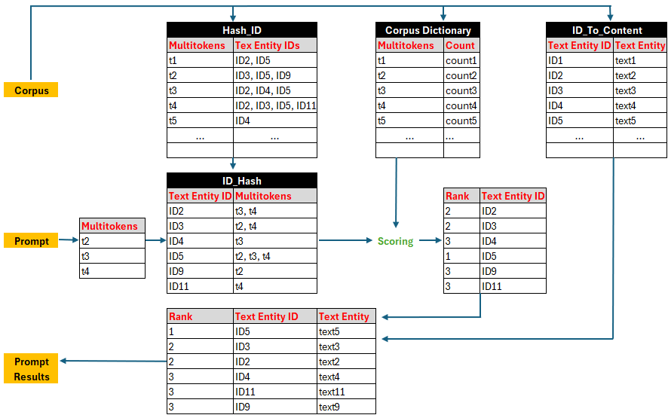
Details: Indexation

Slide 31
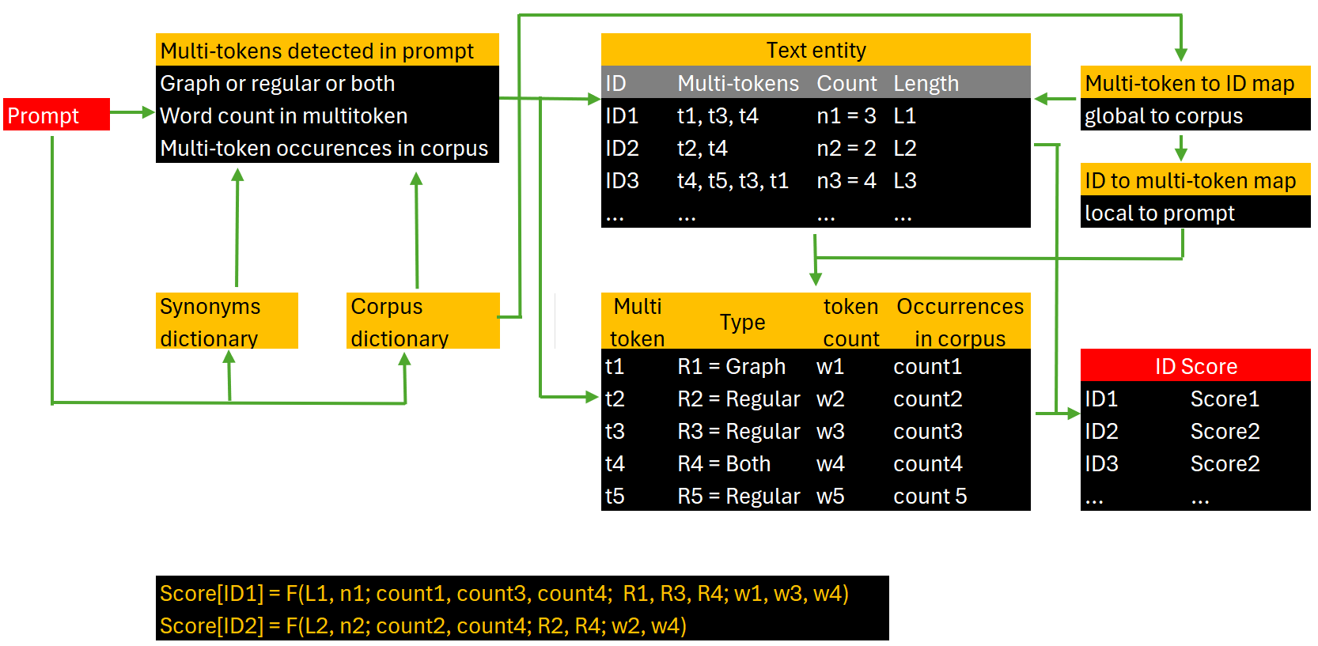
Detail: Relevancy Algorithm

Slide 32
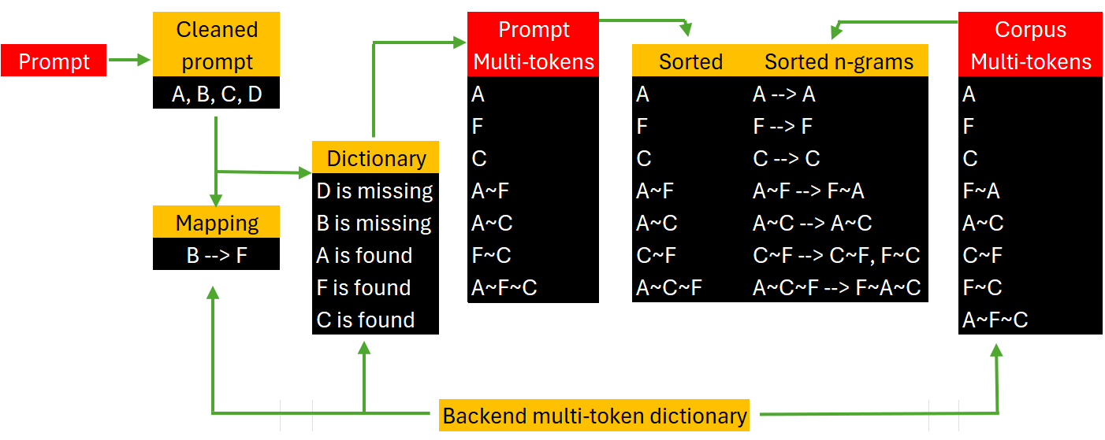
Detail: Sorted N-Grams

Slide 33
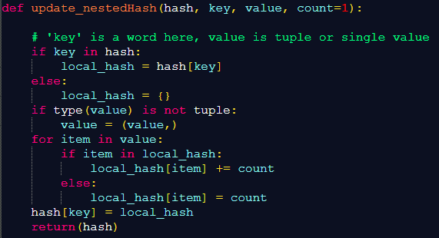
Database: Nested Hashes (like JSON)

Slide 34
Evaluation
User-based (automated)
Collect favorite hyperparameters chosen by users
Use smart grid search to set default hyperparameters based on user favorites
Fine-tune on one or few sub-LLMs (like LoRA) before full optimization on (say) 200 sub-LLMs. You may fine-tune all sub-LLMs in parallel.
Taxonomy-based (automated)
Pretend that the taxonomy backend table comes from external sources
Assign categories to webpages based on this “external” taxonomy
For each webpage, compare externally assigned to native category

Slide 35
Evaluation (Cont.)
Evaluation challenges
We are dealing with unsupervised learning: there is no perfect output except for trivial cases
Quality depends on user (professional users and laymen have different criteria)
How do you measure exhaustivity, depth, and recency?
Output value versus grammatical capabilities
How do you integrate xLLM relevancy scores attached to each item, to evaluate output quality? No other LLM return these scores

Slide 36
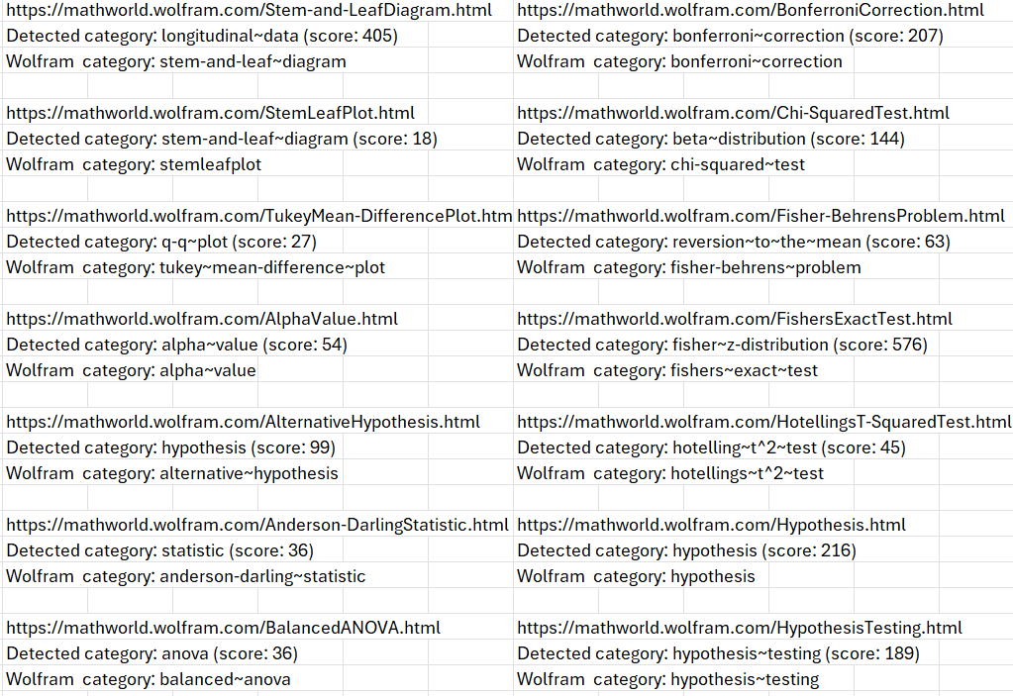
Taxonomy-Based Evaluation

Slide 37
Part 4 xLLM for Clustering, Data Synthetization, Predictive Analytics

Slide 38
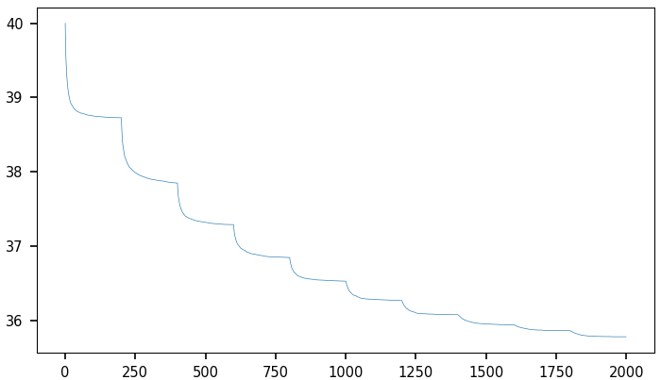
Interlude – Adaptive Loss Function (ALF)
Adaptive loss function converging to model evaluation metric
Boosts quality measured using model evaluation, reduces gradient descent failures

Slide 39
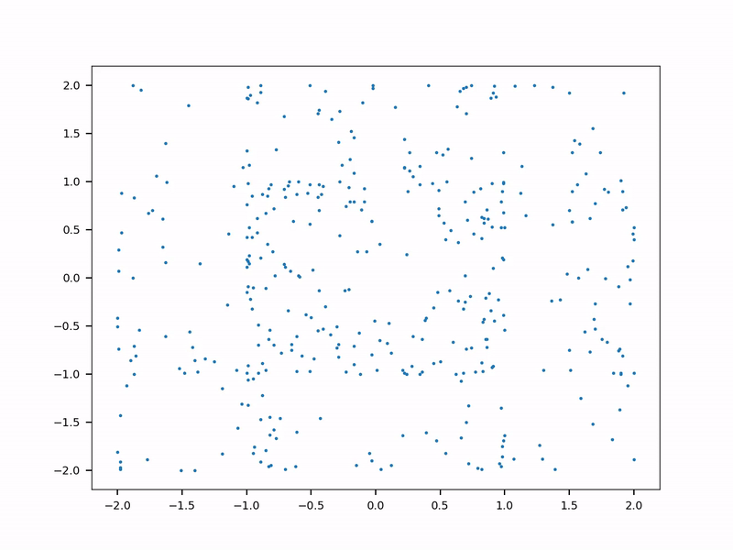
xLLM for Data Synthetization (with ALF)
NoGAN Tabular Data Synthetization
Real data: 2 concentric circles
Synthesized, NoGAN synthesizer: blue dots. Constrained synthetization to keep loss above some threshold
As the loss function gets more granular, the synthesized data gets more similar to the real data (the training set)

Slide 40
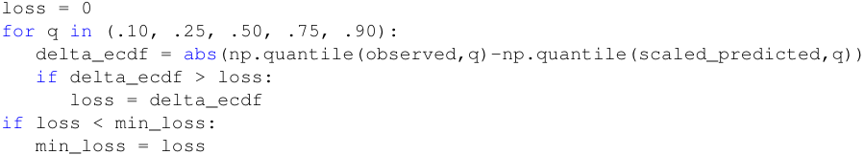
xLLM for Predictions
Case study – media industry
Predicting article performance (pageviews) based on title keywords and category
4000 articles; pageview is normalized and time-adjusted
Evaluation and Loss function (identical)
Based on comparing predicted with observed quantiles, using 5 quantiles (see code)
Good proxy to Kolmogorov-Smirnov distance

Slide 41
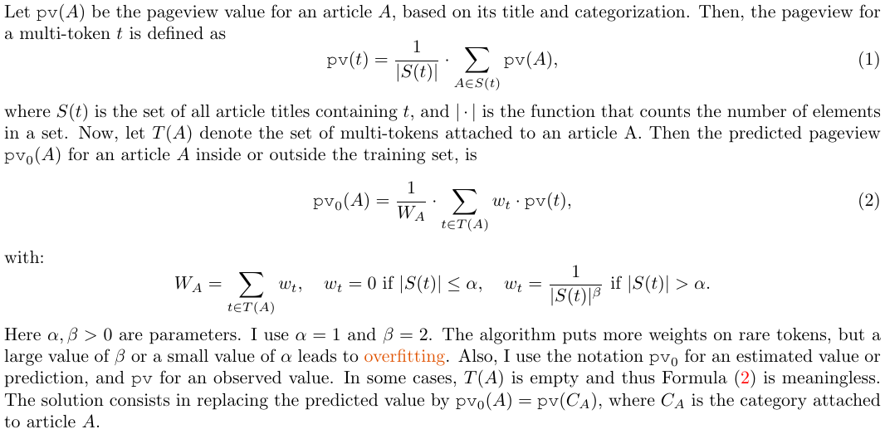
xLLM for Predictions – Model

Slide 42
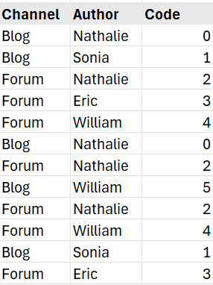
xLLM for Predictions – Category Encoding
Create new codes sequentially as you browse the training set.
Aggregate codes with few observations into bundles.
Create two key-value mappings. Ex:
Category_to_Code[‘Blog’, ‘William’] = 5
Code_to_category[5] = [‘Blog’, ‘William’]
Replace the categorical features by the newly created feature, “Code”.
Number of codes ≤ number of obs.

Slide 43
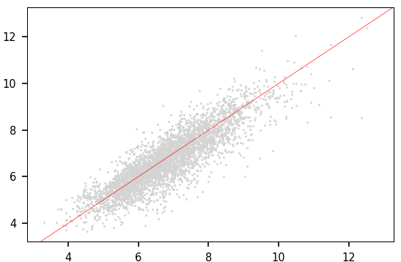
xLLM for Predictions – Results
Observed vs predicted normalized pageview count

Slide 44
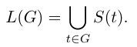
xLLM for Clustering
Case study – media industry
Identifying patterns / clusters in popular articles based on title keywords
4000 articles; pageview is normalized and time-adjusted
Methodology
Group multi-tokens into clusters based on a similarity metric, with hierarchical clustering and k-medoids
Let S(t) be the set of articles containing the multi-token t in the title
For each multi-token group G, the list L(G) of articles belonging to G is

Slide 45
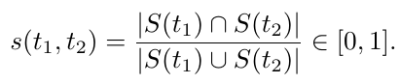
xLLM for Clustering (Cont.)
Similarity between two multi-tokens t₁, t₂
Remarks
Multi-token clusters are non-overlapping, but article clusters may overlap
Sklearn clustering methods require a distance matrix as input; the matrix (derived from the similarity metric) is huge but extremely sparse.
In my implementation, s(t₁, t₂) is computed and stored only if it is strictly positive. Using connected components for clustering, it is far more efficient than Sklearn.

Slide 46
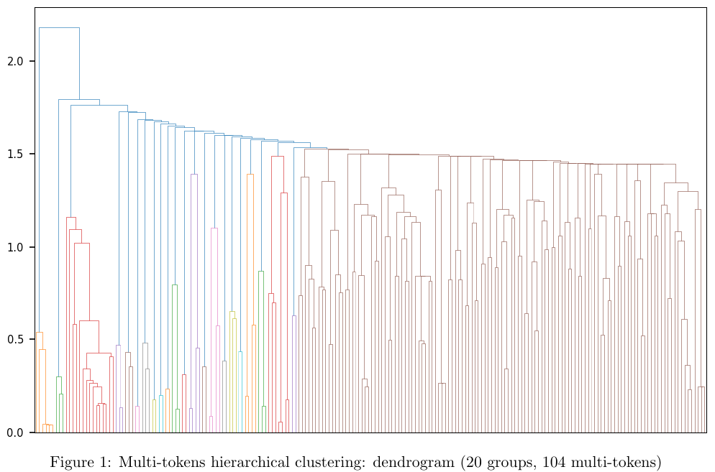
xLLM for Clustering – Sample Structure

Slide 47
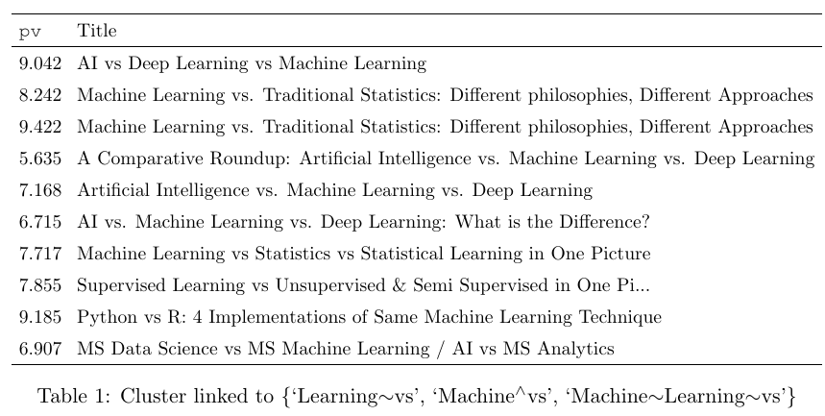
xLLM for Clustering – Sample Cluster
Cluster of popular articles linked to multi-token cluster with 3 elements, including one contextual multi-token: “Machine^vs” (pv stands for normalized pageview)

Slide 48
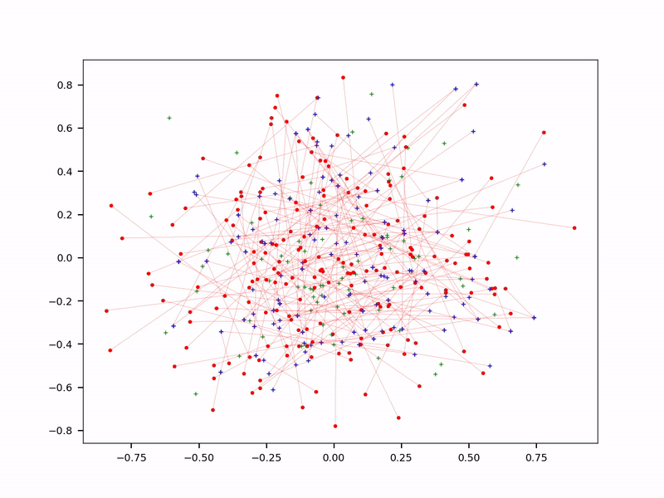
Interlude – Fast Nearest Neighbor Search
Red dot: prompt-derived embeddings
Blue dot: backend table embedding
Over time, arrows link red dots to their nearest blue dots
Alternative to vector search

Slide 49
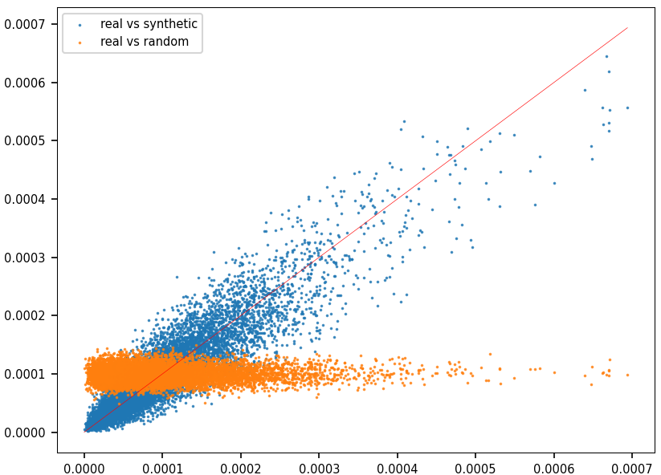
xLLM for Next Token Prediction
Next token prediction: the mother of all LLMs
Here: predict next DNA sub-sequence to generate synthetic genomic data
Alphabet has 4 letters
Left: Scatterplot comparing observed vs synthetic ECDFs

Slide 50
Part 5 References

Slide 51
References
New book: “Building Disruptive AI & LLM Technology from Scratch”
First book: “State of the Art in GenAI & LLMs – Creative Projects, with Solutions”
Project 2.4 – Adaptive loss function
Project 7.2 – Main part, includes smart crawling and x-embeddings
Project 8.1 – Fast approximate nearest neighbor search
Project 8.2 – Evaluation using taxonomy
Project 8.3 – xLLM for clustering and predictions
GitHub: code, data: https://github.com/VincentGranville/Large-Language-Models
AI Research and book access: https://mltechniques.com/resources/

